Slide 1

Smart Push
introduction

Slide 2

Content
01 Product description
02 Feature
03 Application
04 Tech information

Slide 3

01 Product description

Slide 4


Slide 5
02 Feature

Slide 6









8 Remarkable point
Touch to open
Soft closing
Easy assemble
Stepless adjustment
Short react distance
Can stop in any position
Durable
Wide application

Slide 7
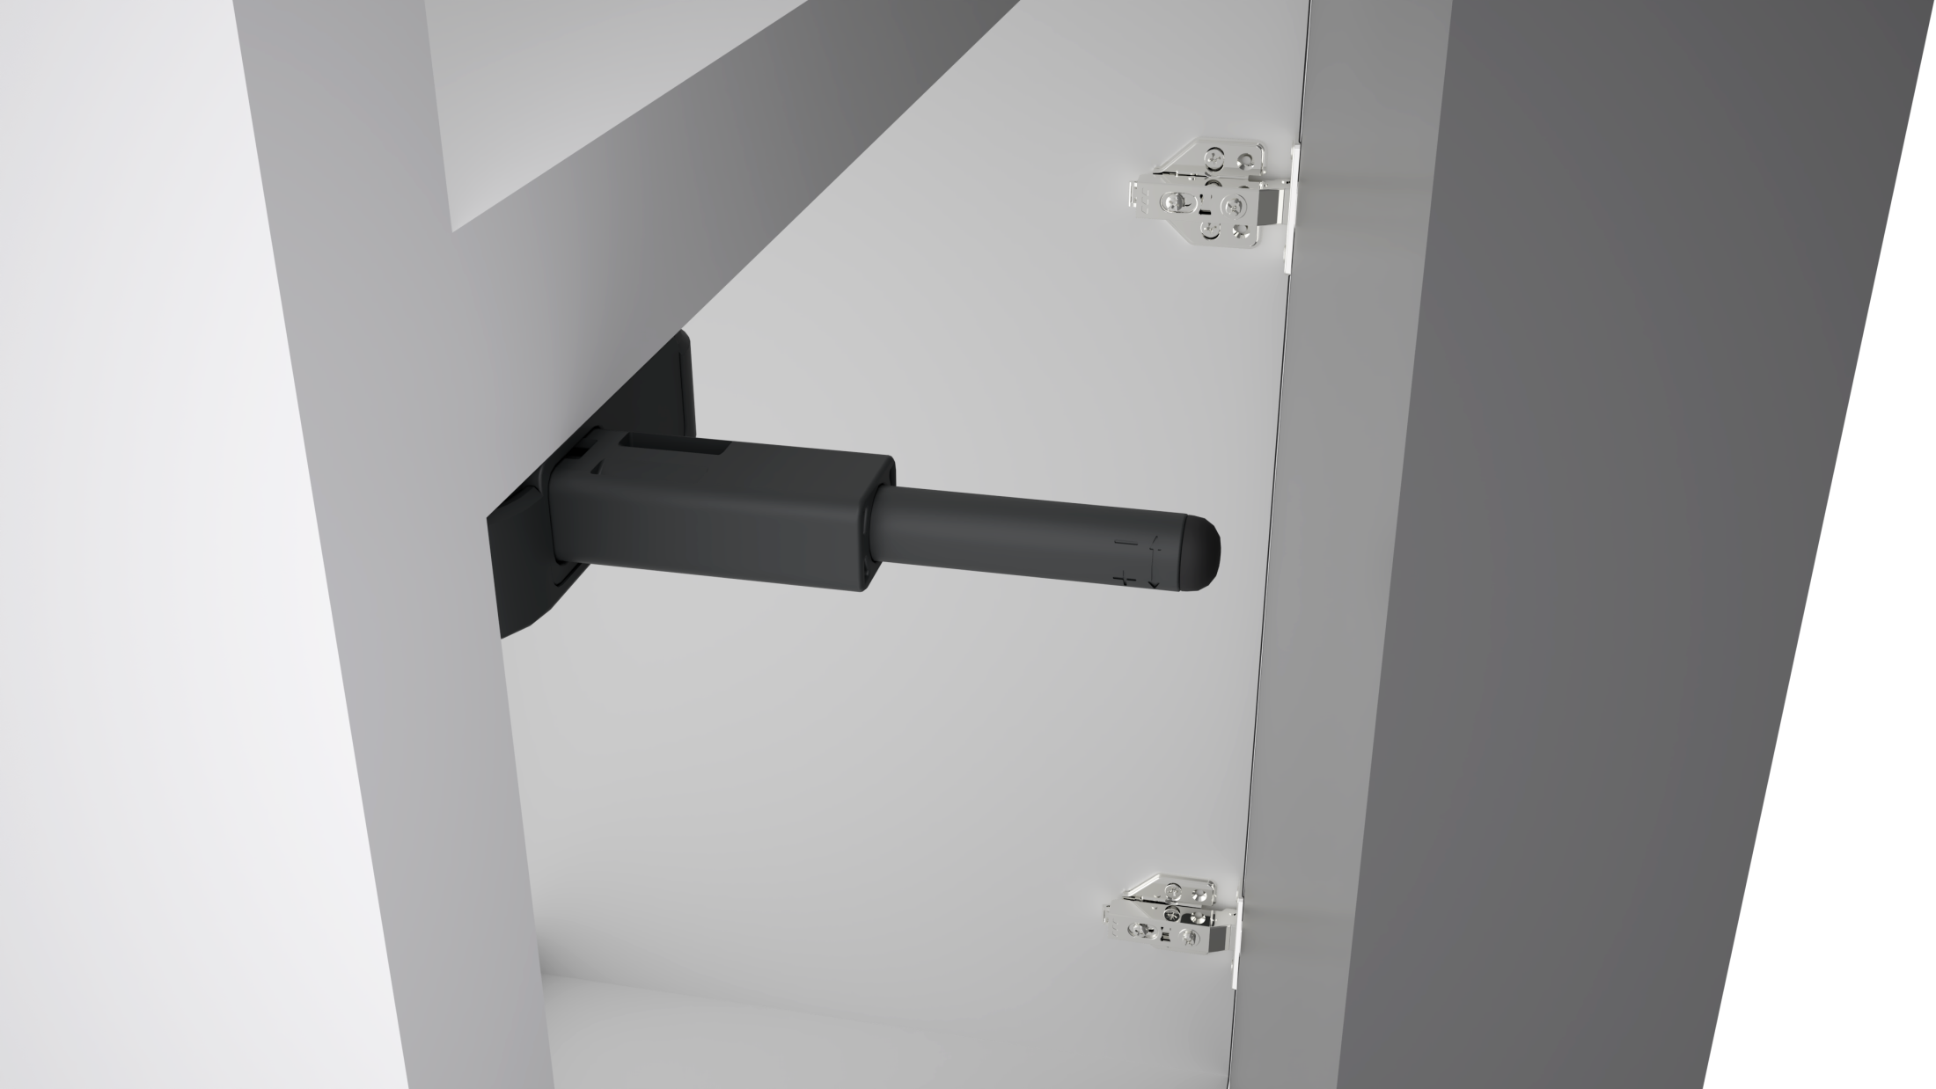


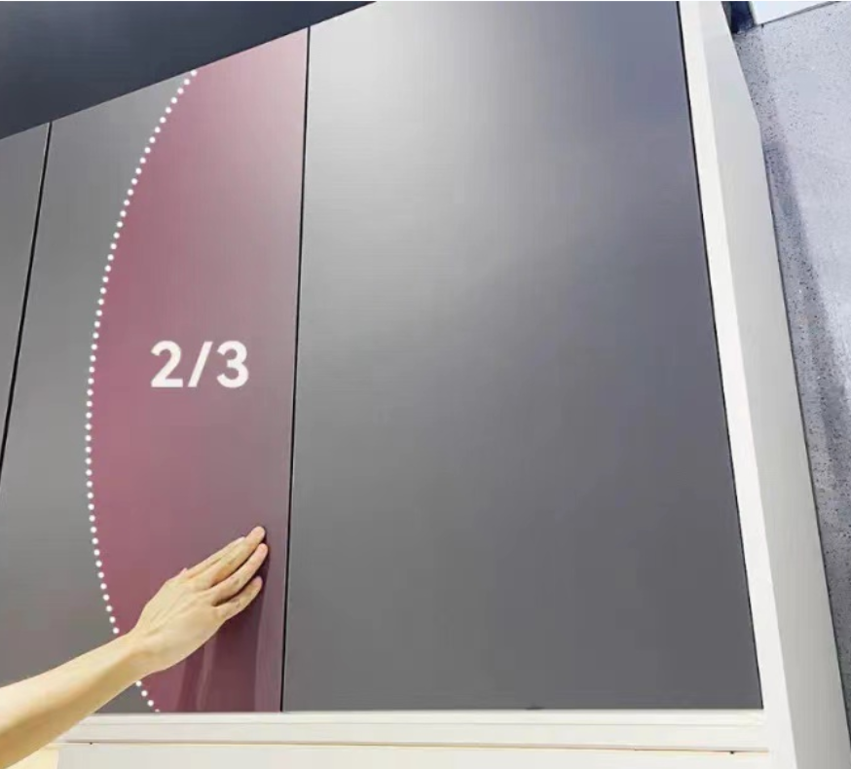

Touch to open
56mm pup up distance
Small push pressure
Reaction area 2/3 door
56mm

Slide 8
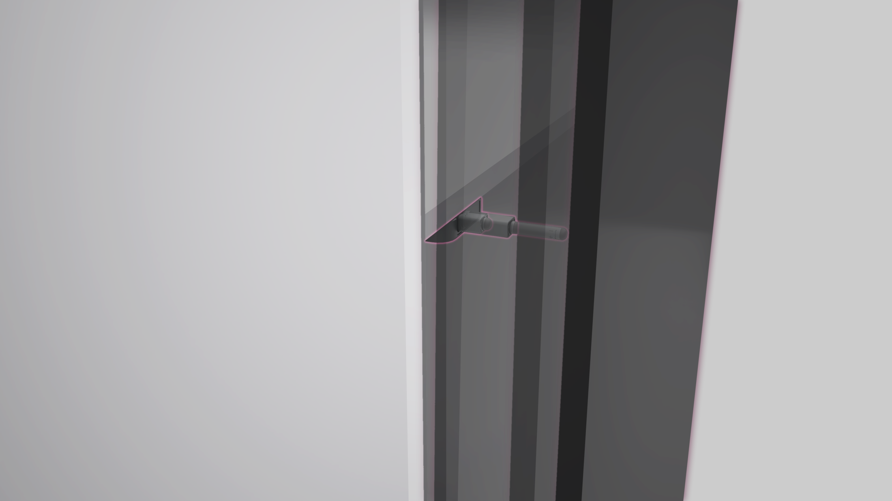


Soft closing
Simpify the door closing movement, no need to push the buffer again.
Soft closing , slient and stable

Slide 9
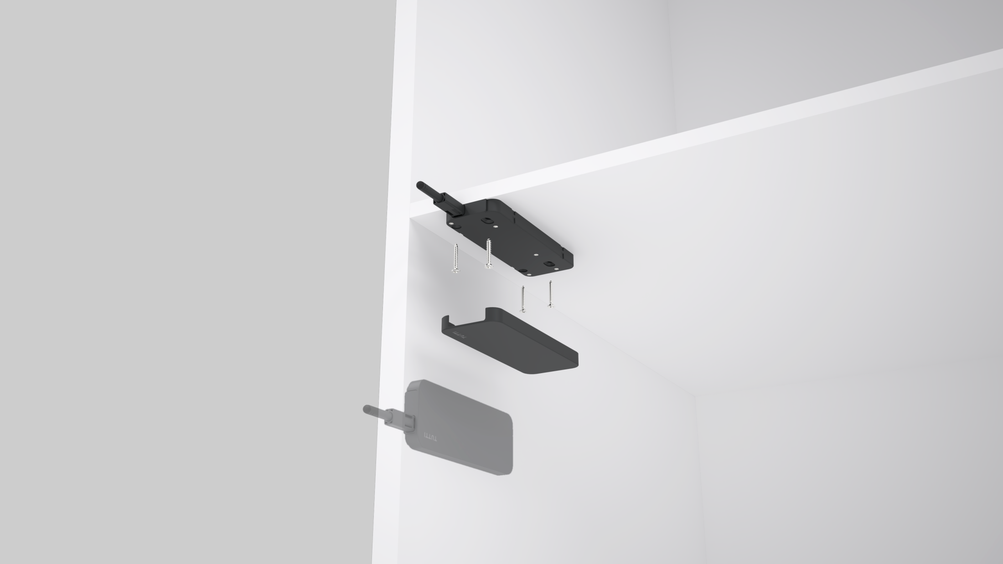

Easy assmble
No need to pre-holed
Install with screw directly
Optional Installation position :
Top plate
Bottom plate
Side plate

Slide 10
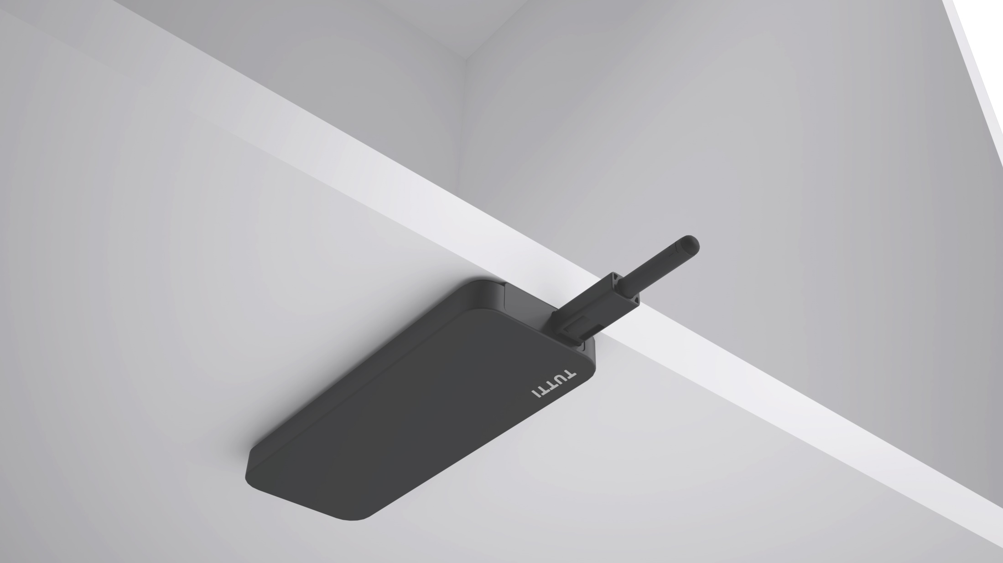


Stepless adjustment
Twist to adjust
Adjustment range 0~+5mm
Easy to adapt the disform issue on the door
0~+5mm

Slide 11
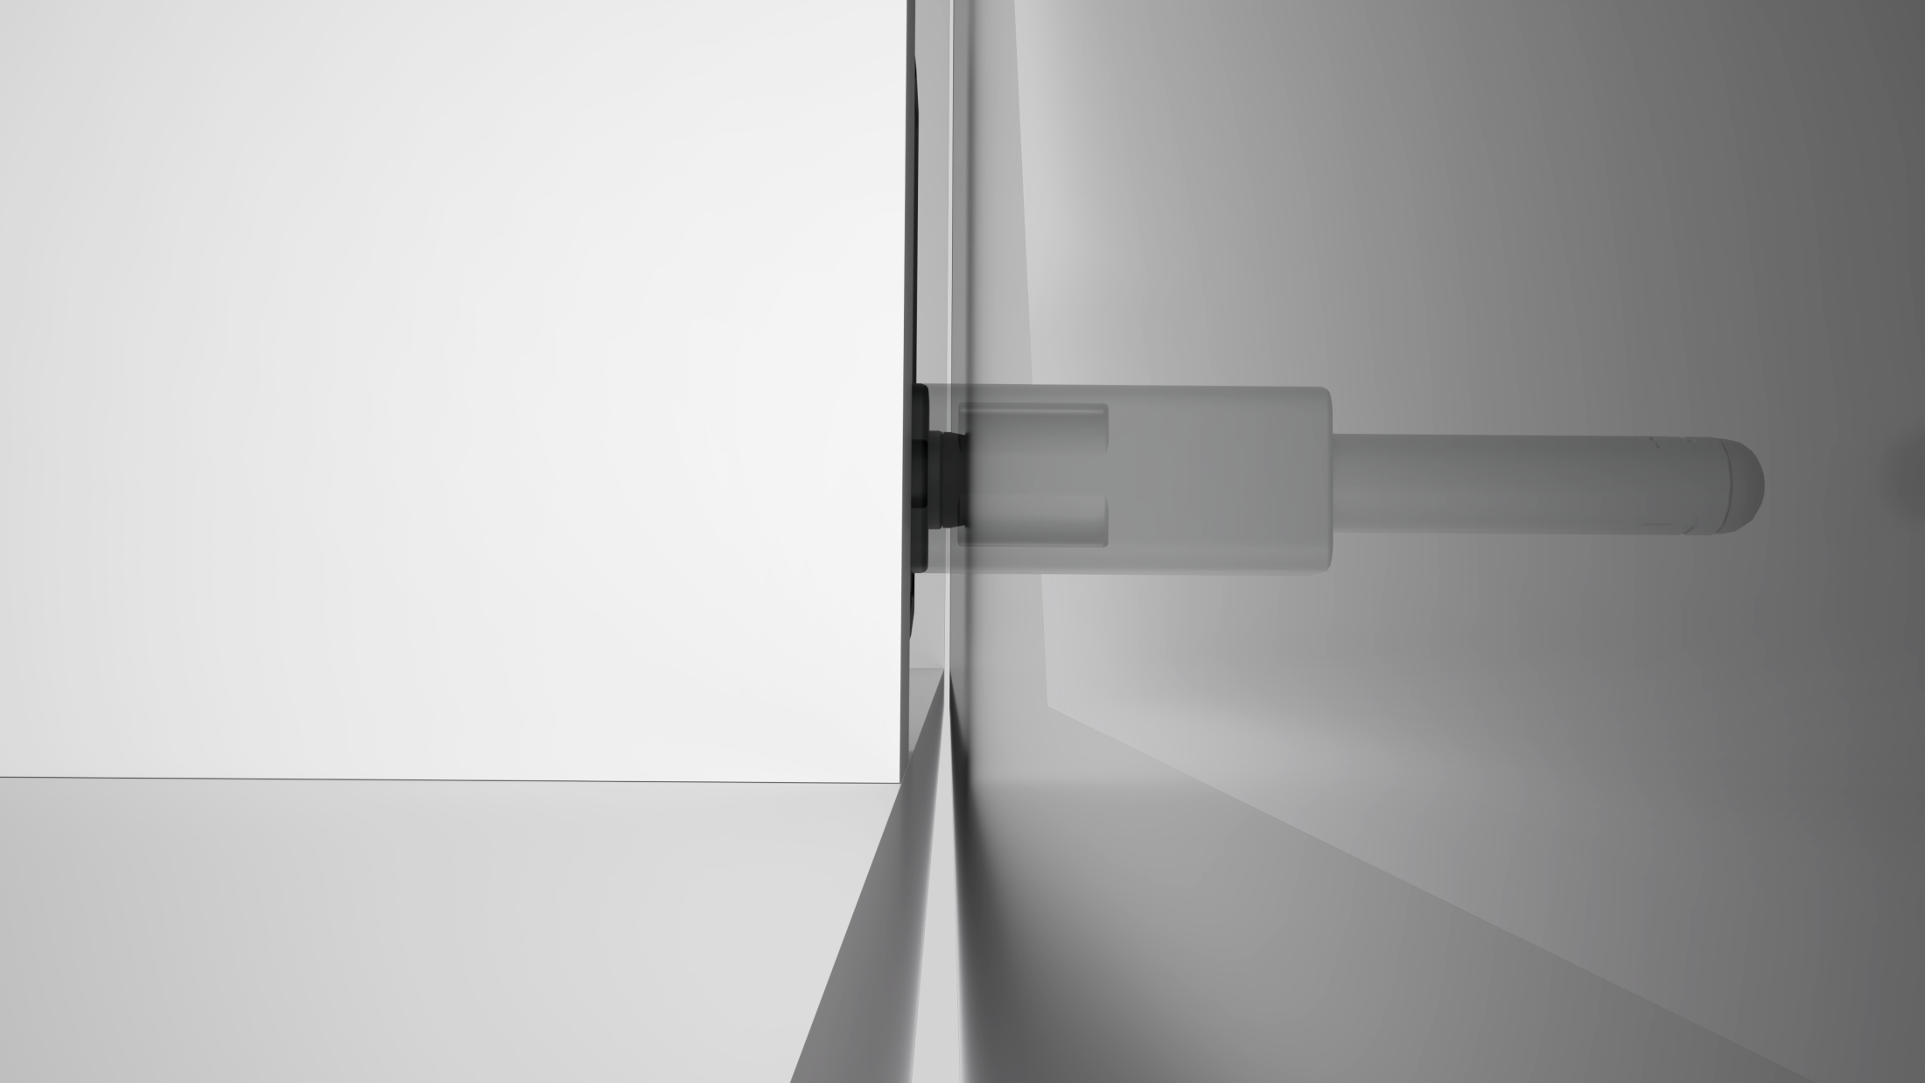

Super short
react distance
2mm Min react distance
High sealing performance
Small door seam
2mm

Slide 12
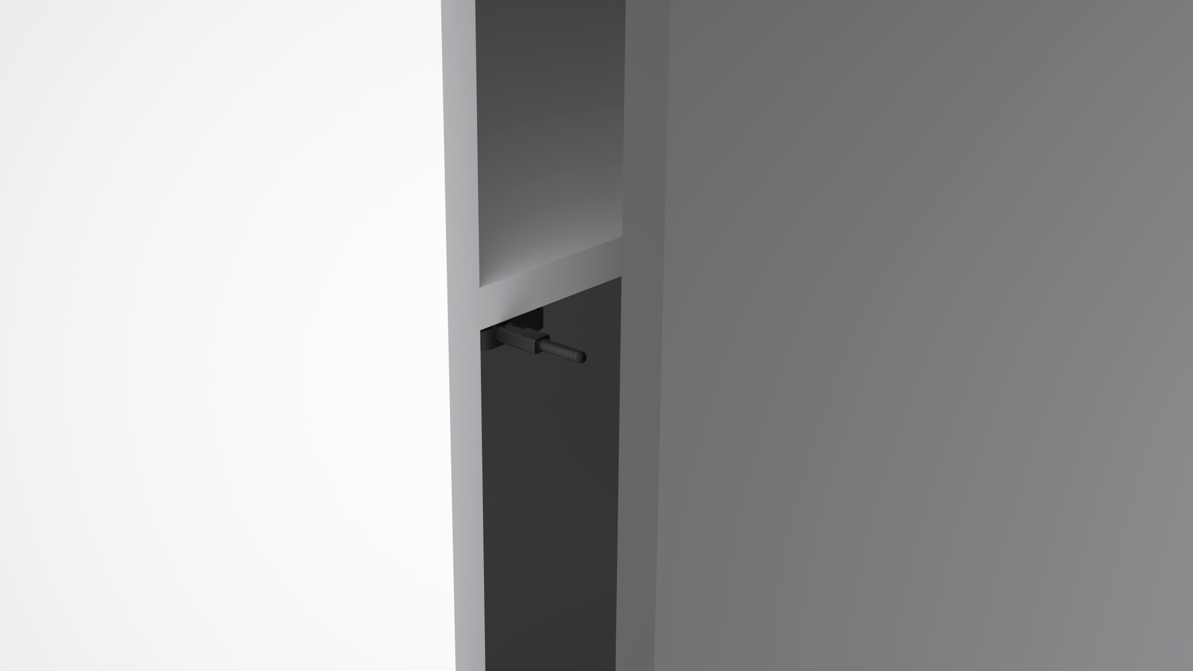

Can stop in any position
No need to open the whole door
Support the small-angle door closing

Slide 13


Durable
Mechanism structure ,precious and stable
Lift circle can reach 60000 time

Slide 14
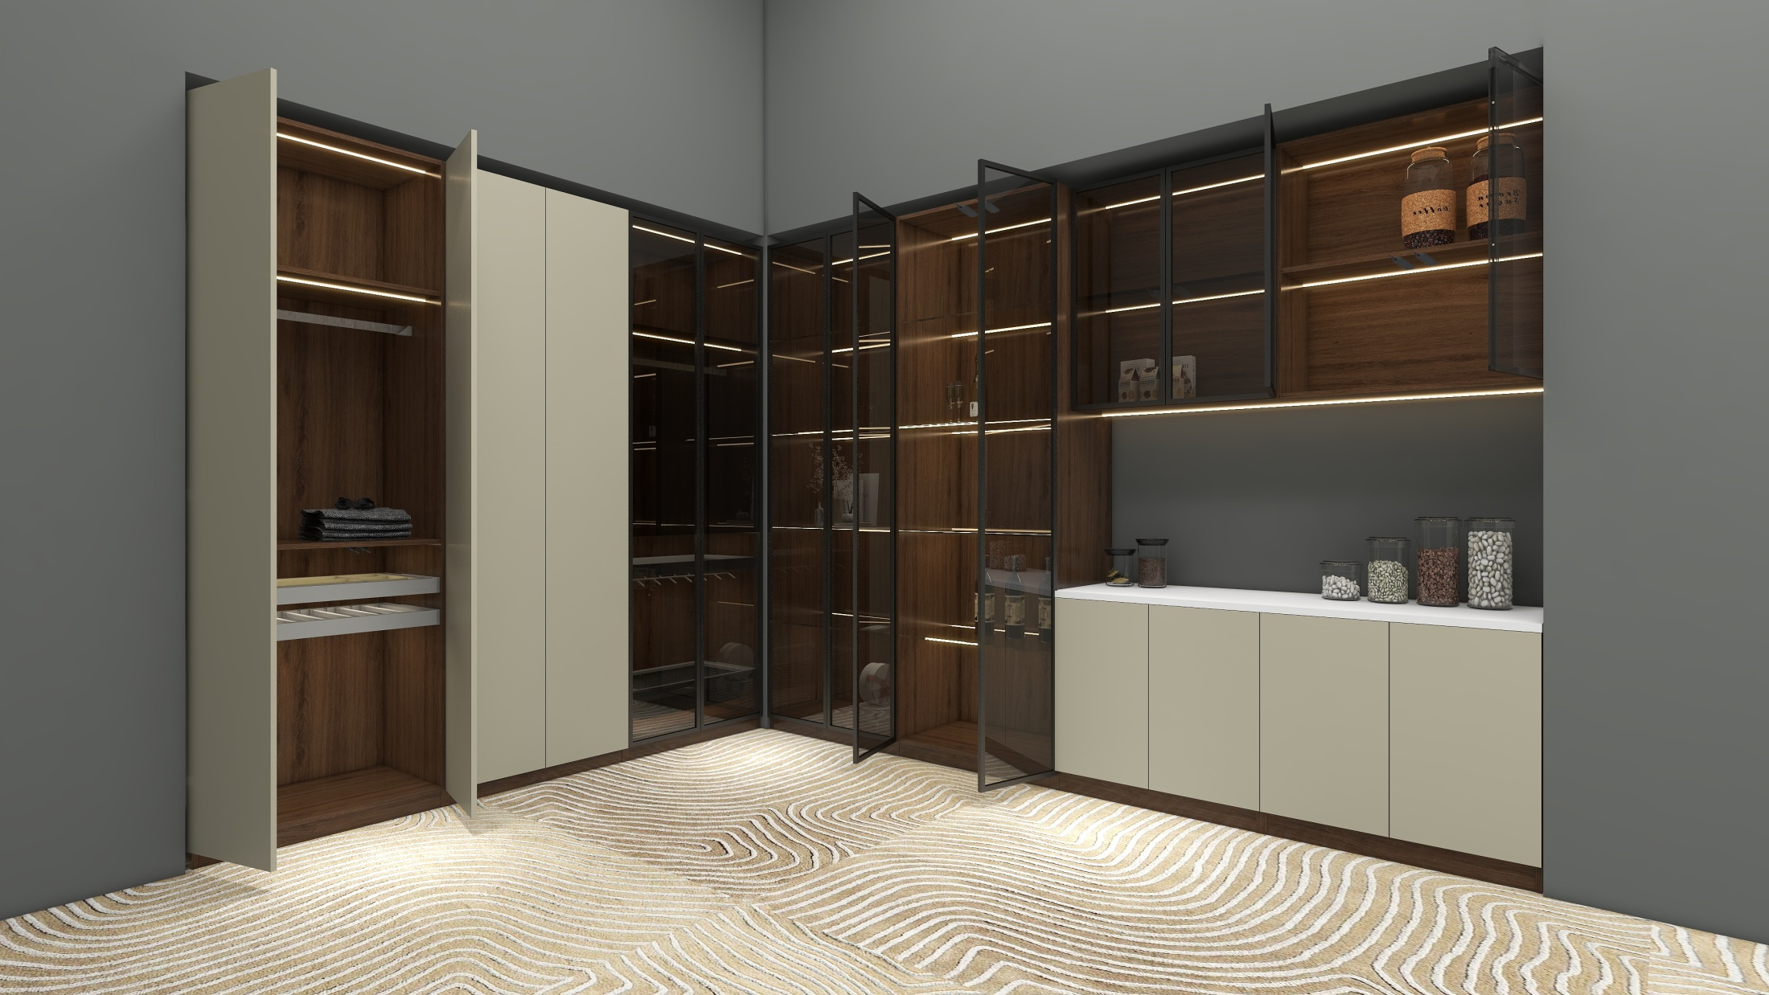

Wide application

Slide 15
03 Application

Slide 16
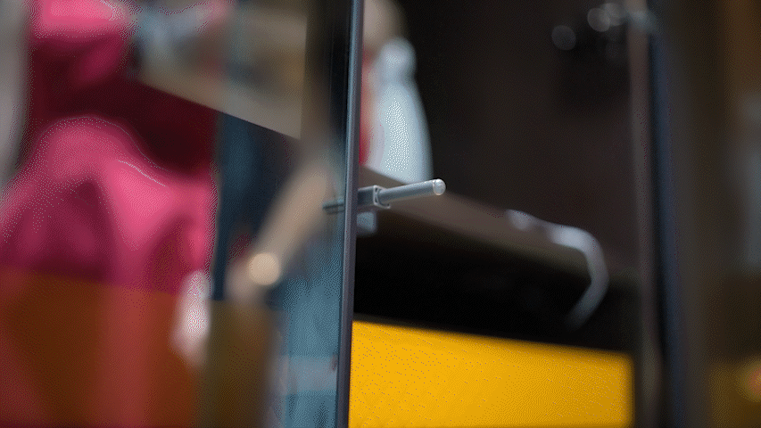
Aluminum door

Slide 17
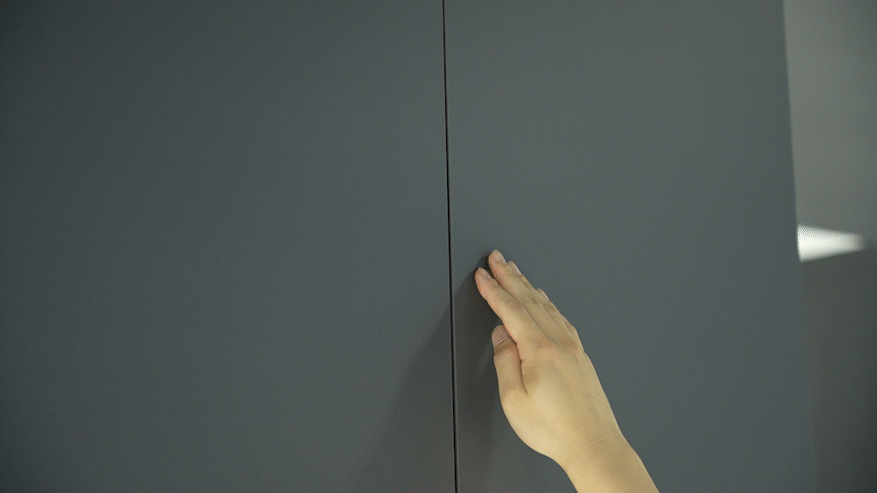
Wooden door

Slide 18
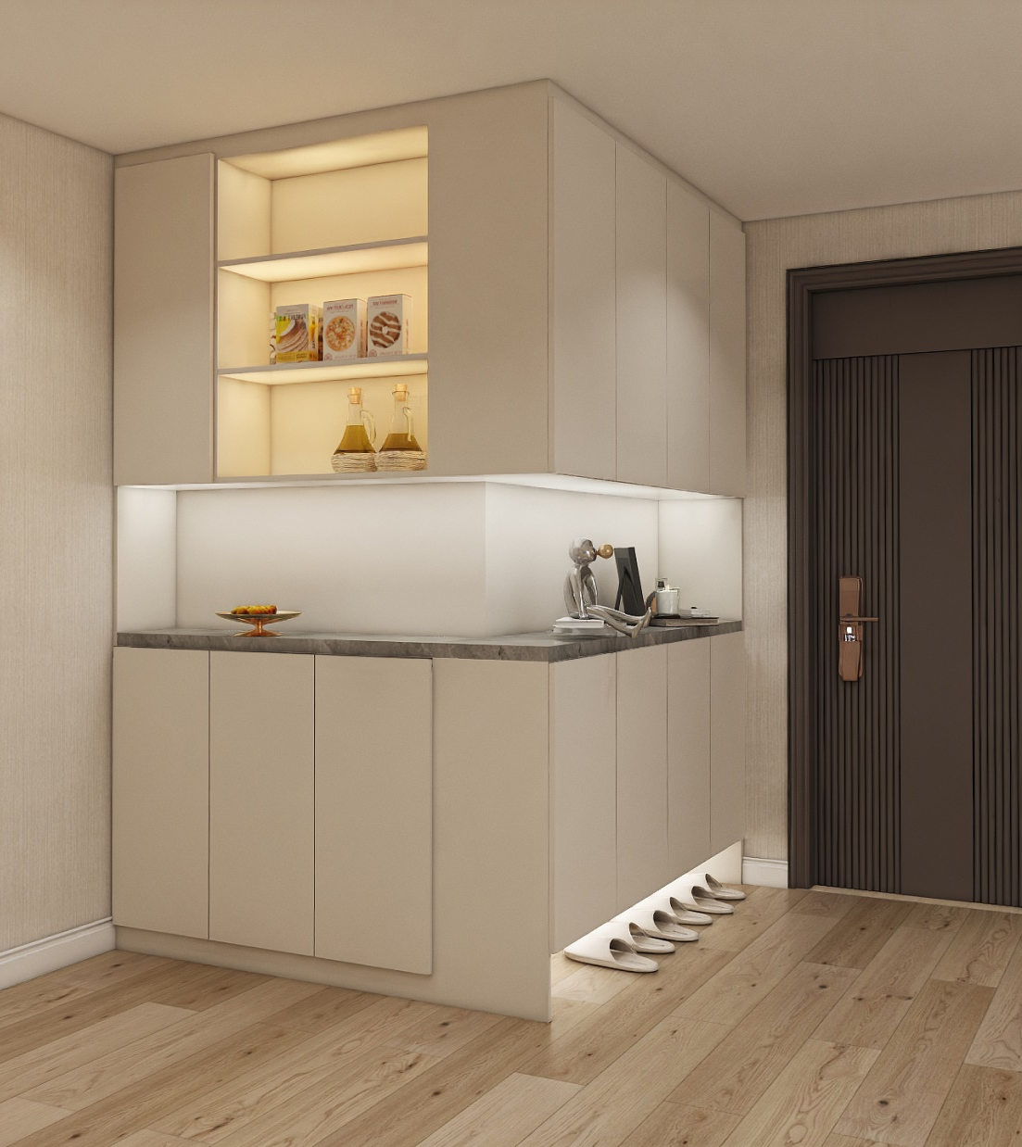


Slide 19
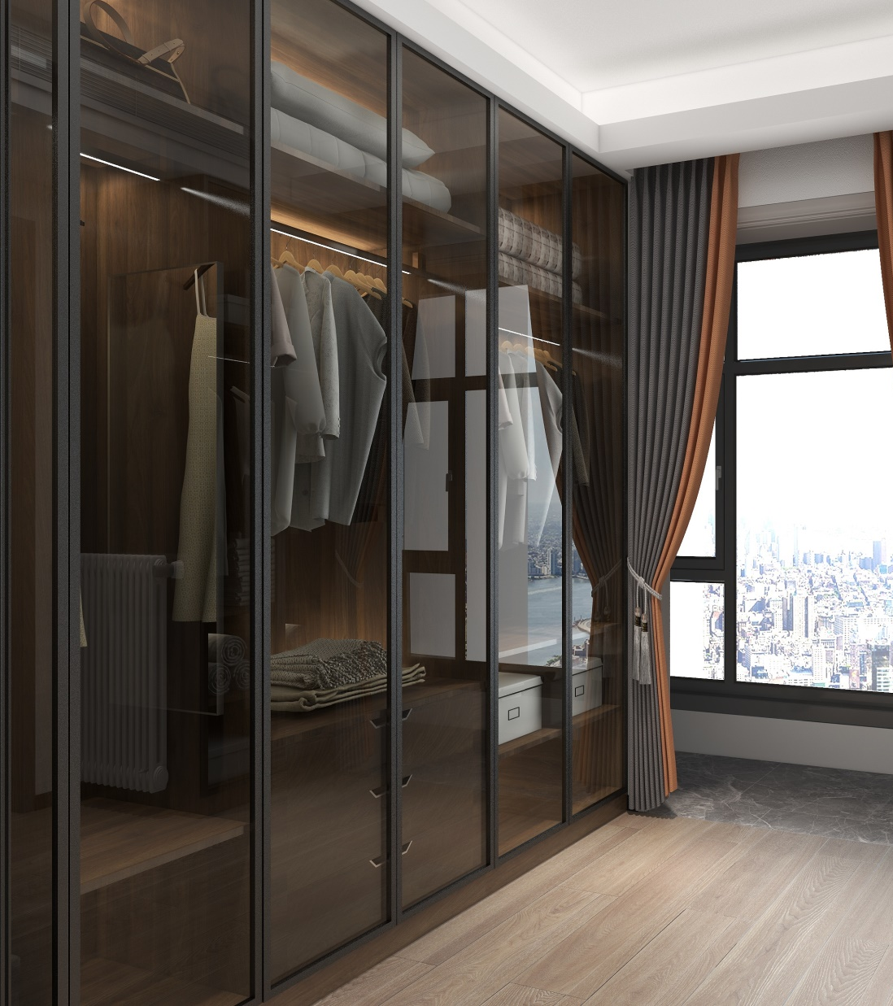
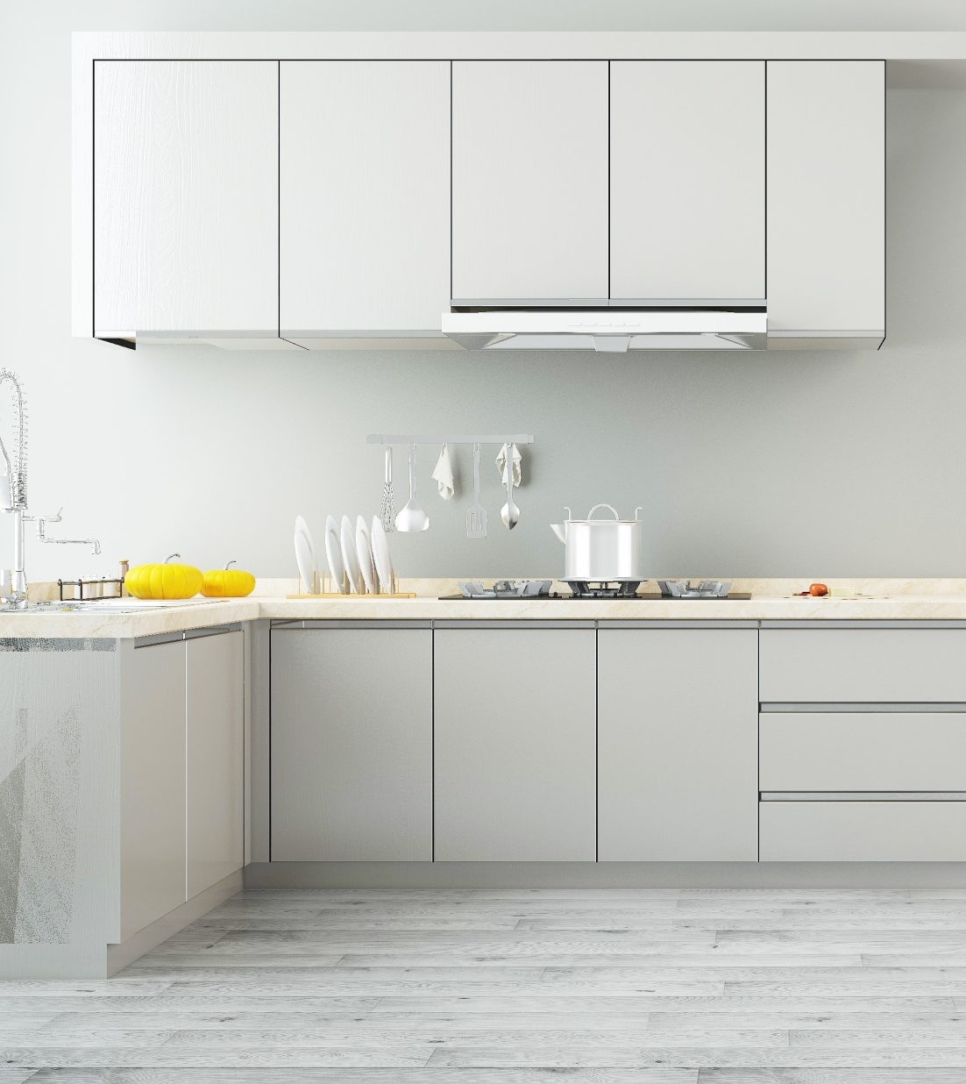

Slide 20
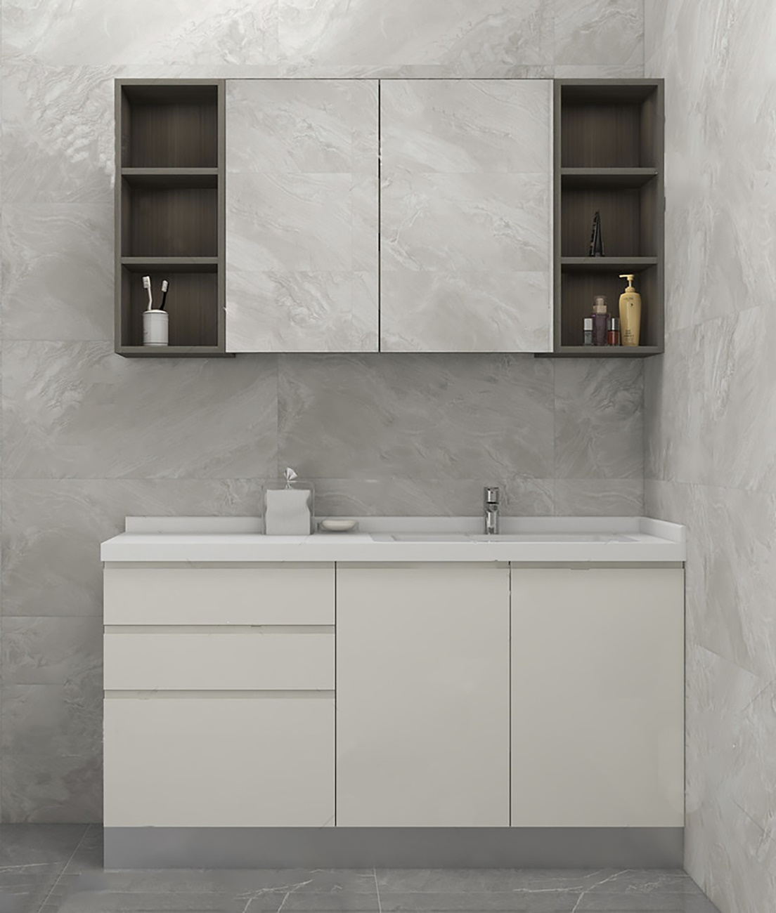
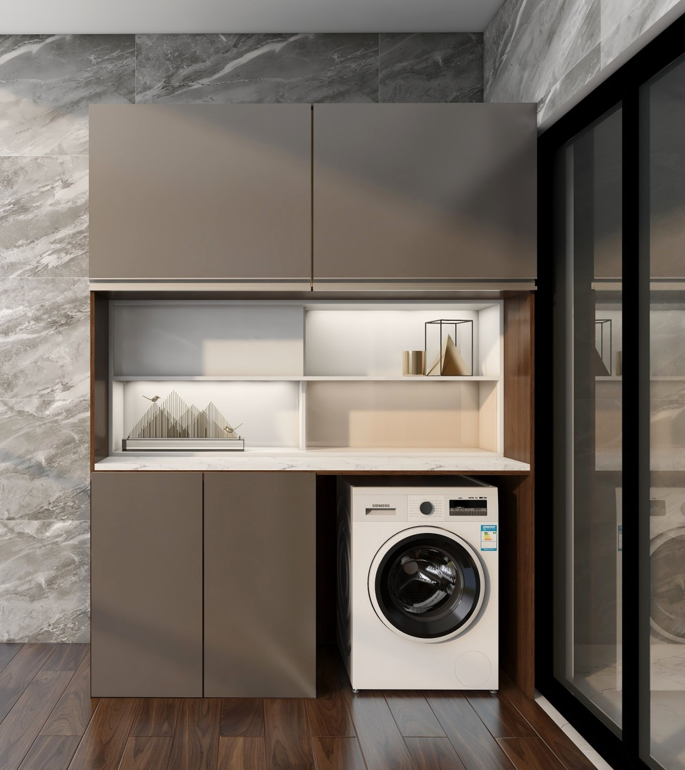

Slide 21
04 Tech information

Slide 22

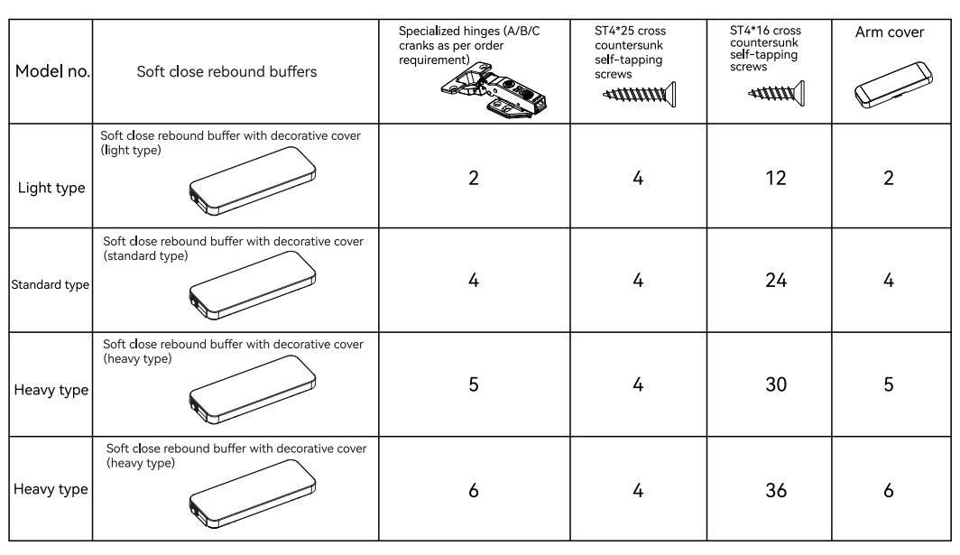
Model and detail
（1 set/box，20 box/ctn）

Slide 23
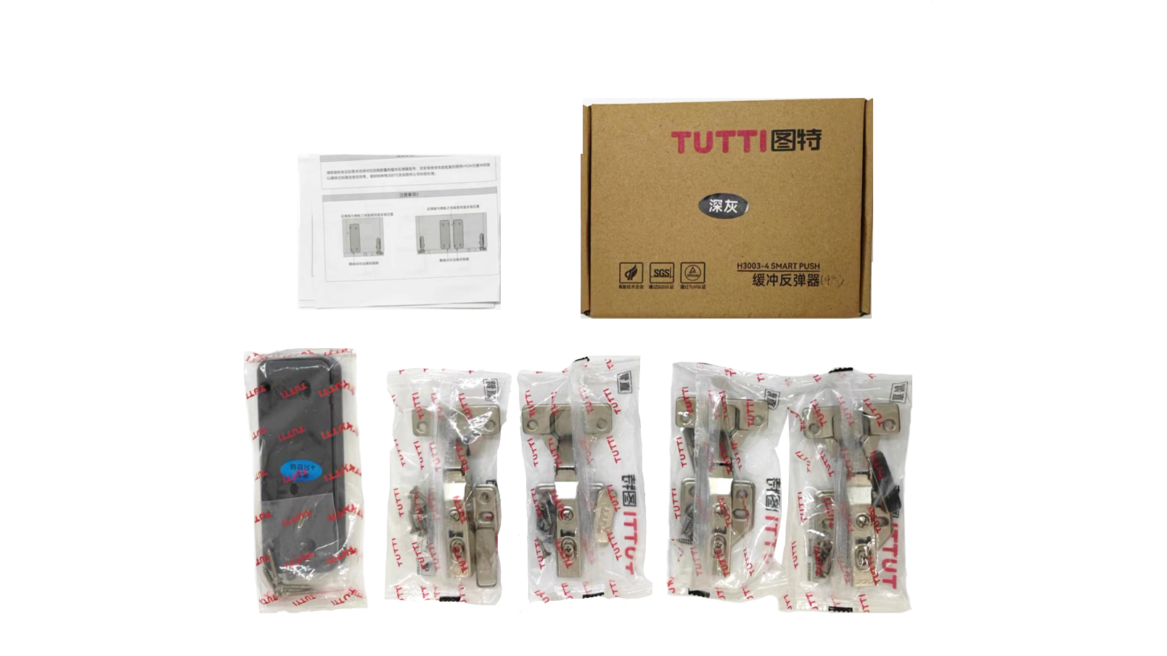
Packaging
Instruction
inner box
Buffer
Hinge

Slide 24
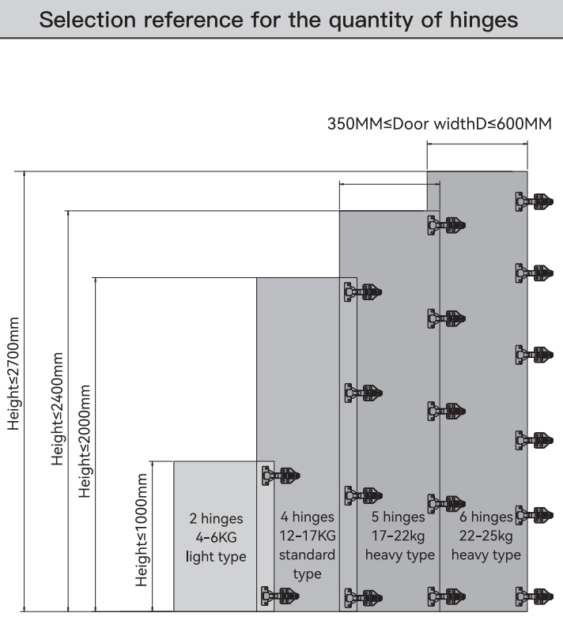
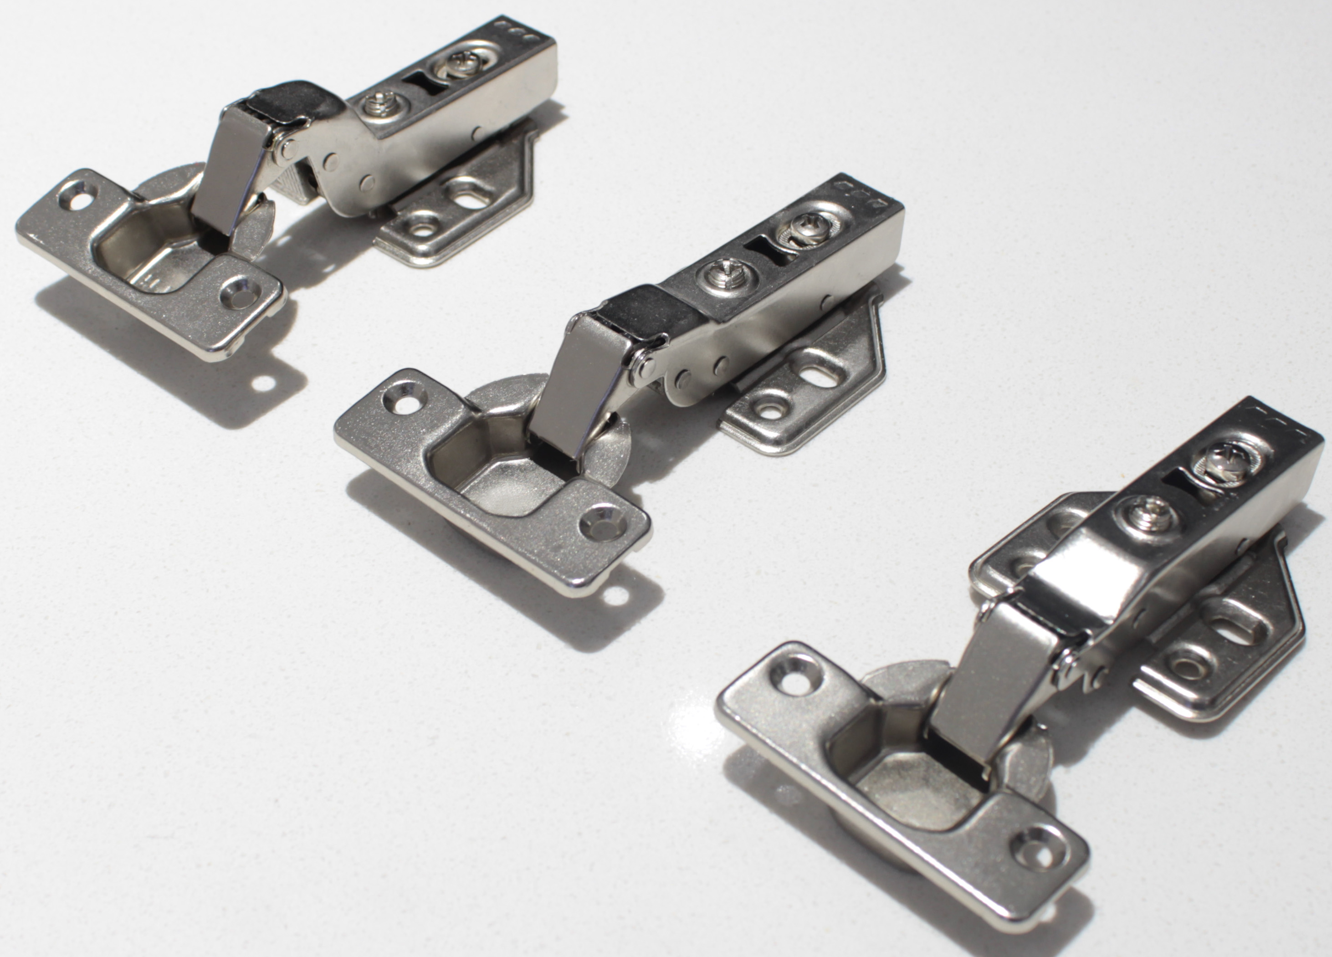
Model and detail-2
Special Hinge for smart push--H92N
The customer can choose the model according to different door weight

Slide 25
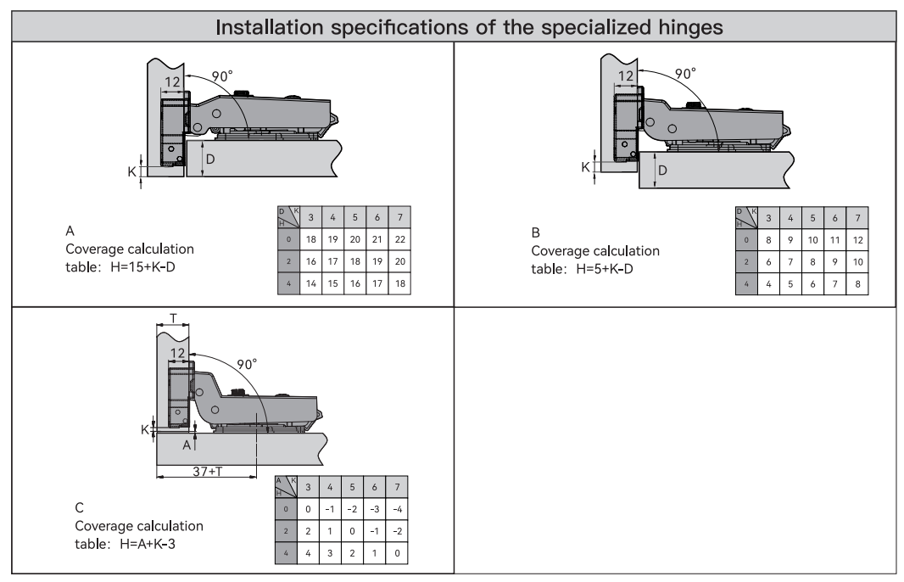
Smart push Hinge informations

Slide 26
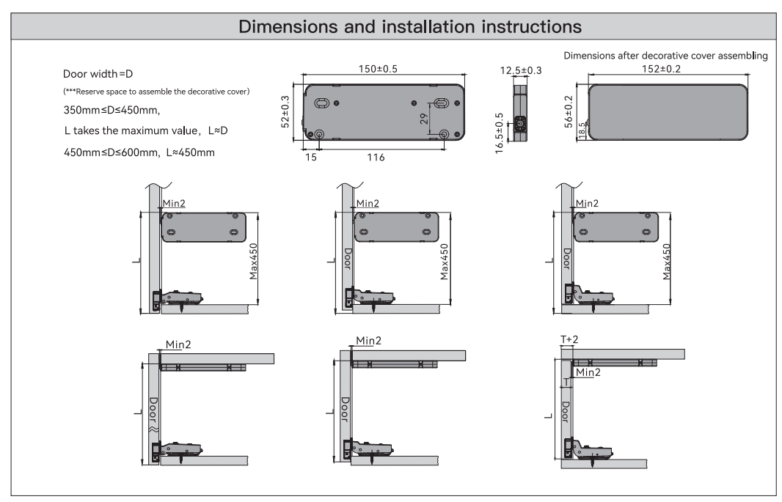
Product size and assemble

Slide 27
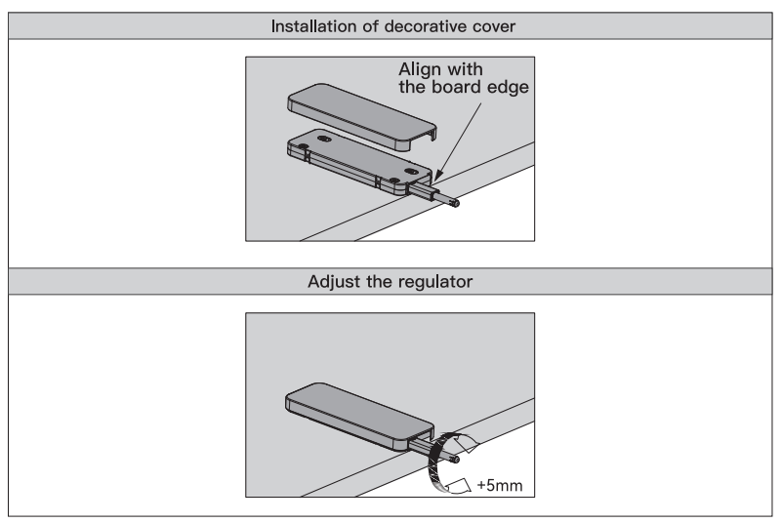
Assemble- Step 1

Slide 28
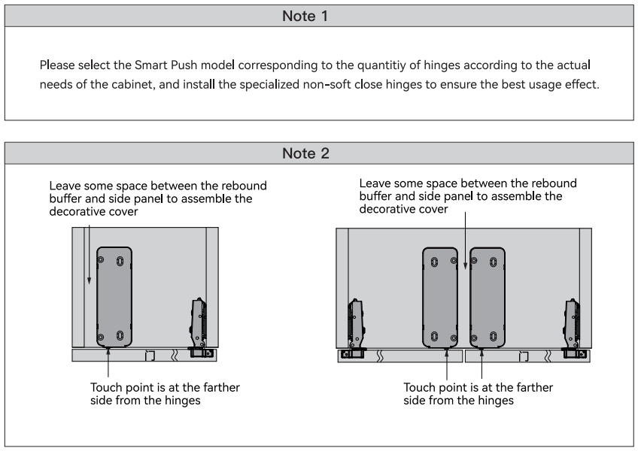
Note

Slide 29
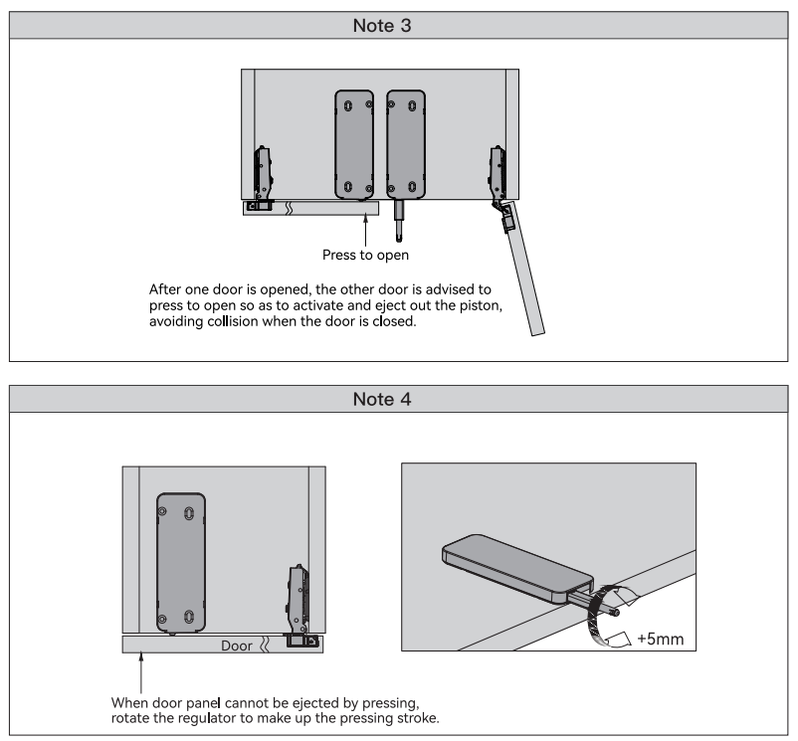
Note

Slide 30
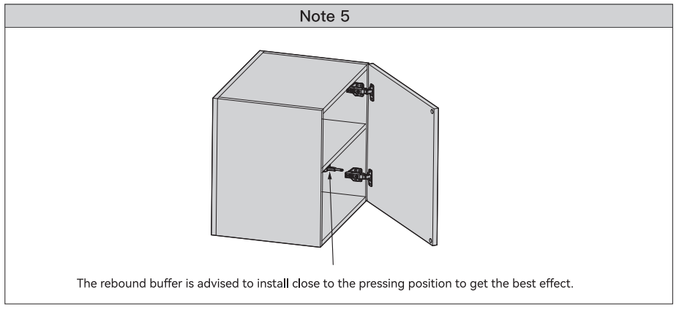
Note

Slide 31

Thanks

